Slide 1
Medical Image Classifier Model
CECS 456 Project
Edwin Bulnes

Slide 2
Introduction
Goal is to create a Convolutional Neural Network to classify medical MNIST data
Keras framework was used to build CNN layers
Keras was also used to load and split the dataset
MatPlotLib was used to create visualizations
Dataset chosen because it is an interesting example of ML in medicine
Results compared against AlexNet CNN

Slide 3
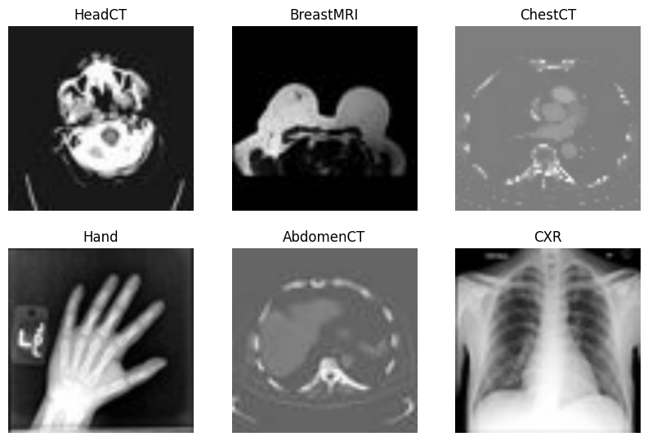
Dataset details
Contains over 58,000 images across 6 categories
https://www.kaggle.com/datasets/andrewmvd/medical-mnist
Combined from separate sets at MAYO Clinic, NIH, RSNA and TCIA
Used in Nvidia Deep Learning Institute paper
Medical Image Classification Using the MedNIST Dataset

Slide 4
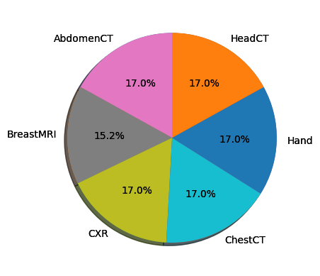
Dataset details
Classes are relatively balanced
each category ranges from 15.2% to 16.9% of overall dataset
Image sizes are standardized throughout dataset
Images are saved as rgb, not grayscale

Slide 5
Related Works
Convolutional Neural Network
Consist of:
convolution layers that extract features based on kernel/filter size
pooling layers that help manage the number of features
Fully connected layers that create an output
AlexNet
Groundbreaking design that uses large 11 x 11 filters
VGG
Demonstrated that smaller 3 x 3 filters and deeper networks can result in better performance with fewer parameters

Slide 6
Methodology
The idea was to create two different models applying approaches from the VGG and AlexNet papers
Model 1: AlexNet-like CNN
uses larger filters earlier in the model
Model 2: VGG-like CNN
uses smaller filters
uses the VGG pattern of stacks of 3 x 3 convolutional layer followed by max pooling layer
Both models are sized-down as this is an obviously smaller data set than what VGG and AlexNet were designed for
Additionally, will use AlexNet CNN as a comparison for the models’ performance

Slide 7
Experimental Design
Preprocessing
Used keras.utils.image_dataset_from_directory to extract dataset
labels were created based on the folder structure
Data Split
dataset was split using keras
divided into 70/20/10 training/validation/test sets
Batch Size
Purposefully used large batch size to try to produce better training per epoch

Slide 8
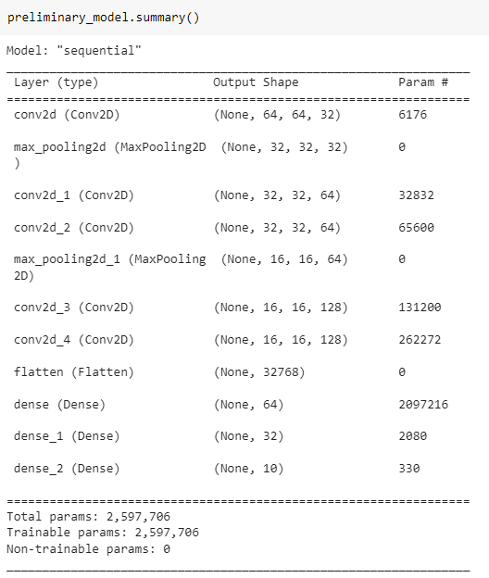
Experimental Design: Model1 (AlexNet-like)
Model1
Input size of 64 x 64 x 3
Left unchanged after experimenting with different sizes
Conv2D
started with kernel_size = 8 x 8
reduced to 4 x 4 in deeper layers
ReLu activation
Dense layers
large numbers of units

Slide 9
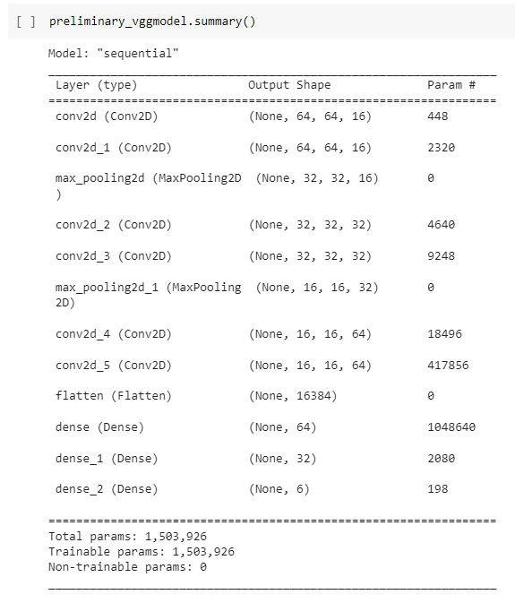
Experimental Design: Model2 (VGG-like)
Model2
Input size of 64 x 64 x 3
Left unchanged after experimenting with different sizes
Conv2D
started with kernel_size = 3 x 3
followed VGG pattern of stacks of Conv2D layers followed by MaxPooling
ReLu activation
Dense layers
reduced units of output layer to match number of classes

Slide 10
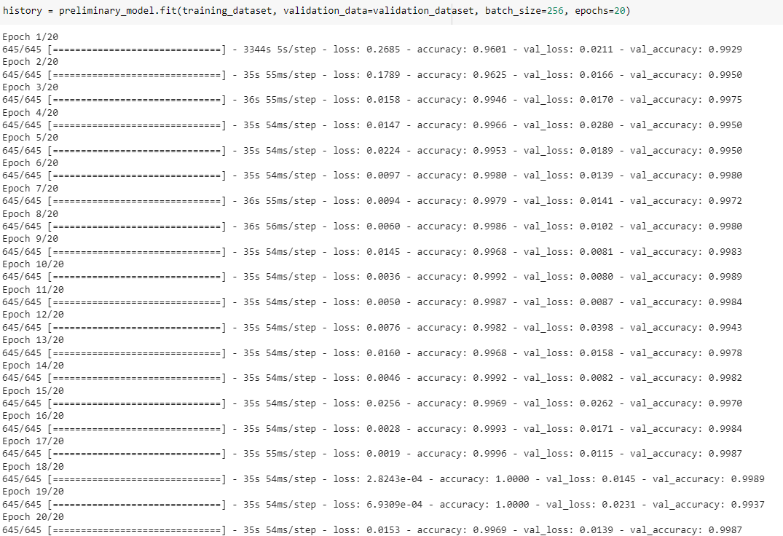
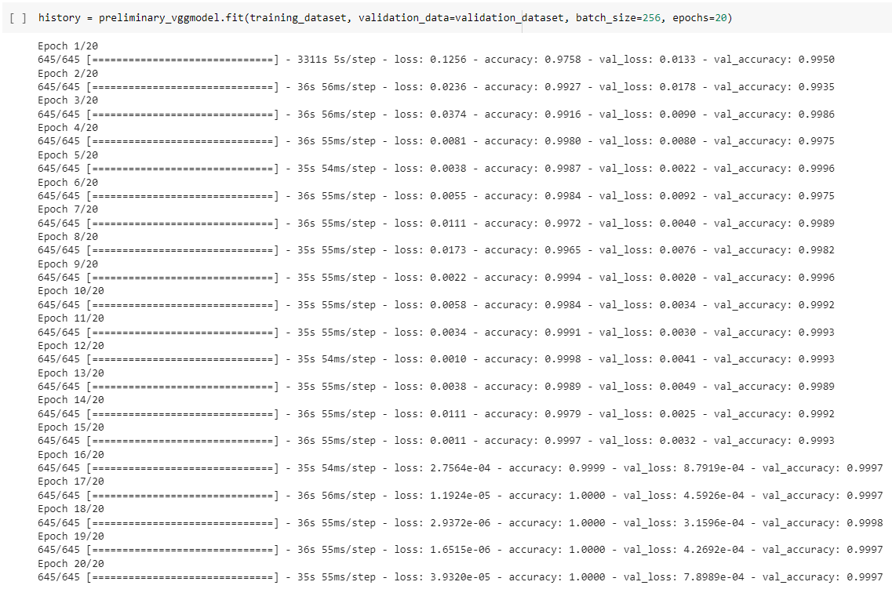
Results
Model1
Model2

Slide 11

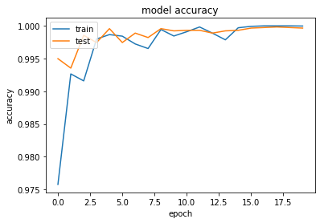
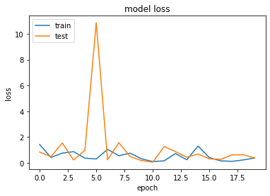
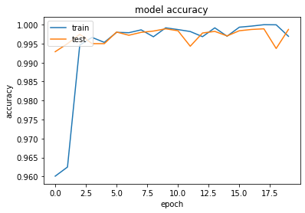
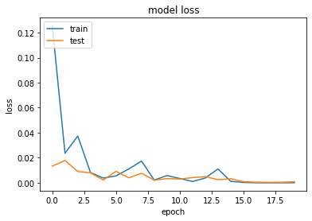
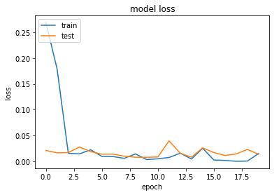

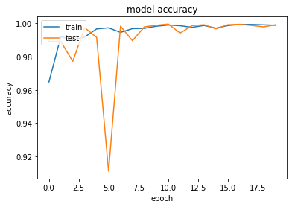

 | Model 1 (AlexNet-like) | Model 2 (VGG-like) | AlexNet
Model Accuracy
Model Loss
Test Loss Test Accuracy

Slide 12
Conclusion
All 3 models performed similarly, implying that there is likely some overfitting happening
I avoided augmenting the data because medical images often have a standard orientation, and I didn’t want to add noise
As expected, the VCG-like model (model 2) performed well with fewer parameters

